Slide 1
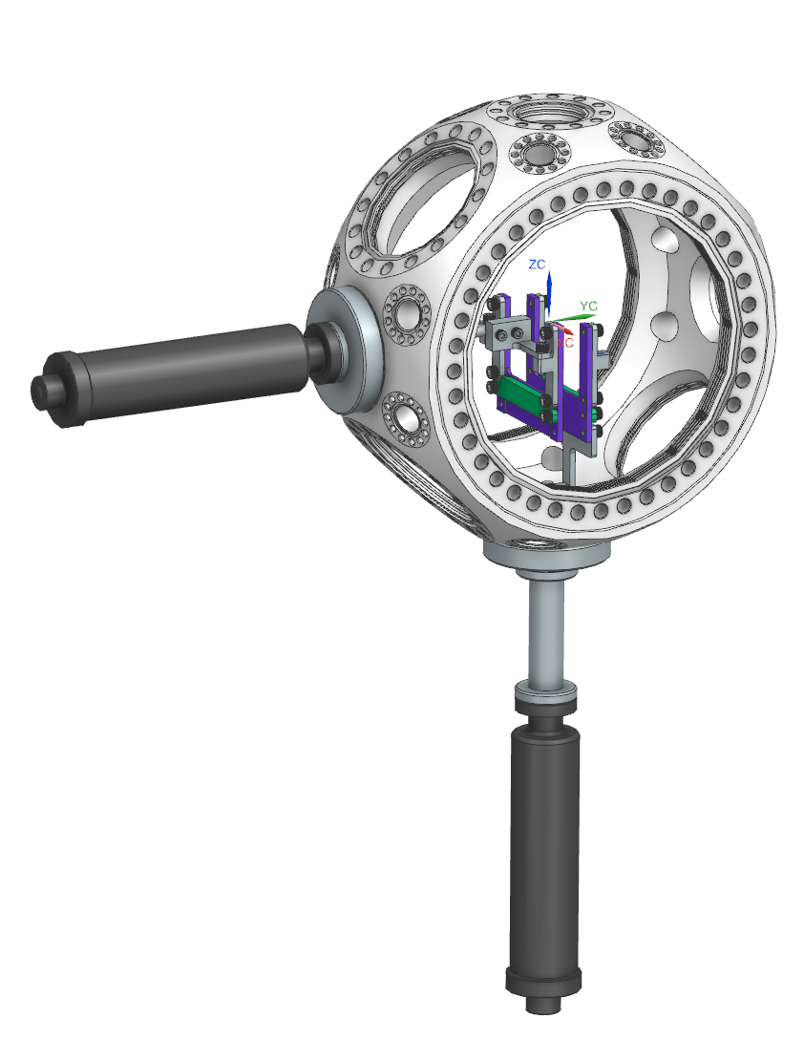
Full Assembly

Slide 2
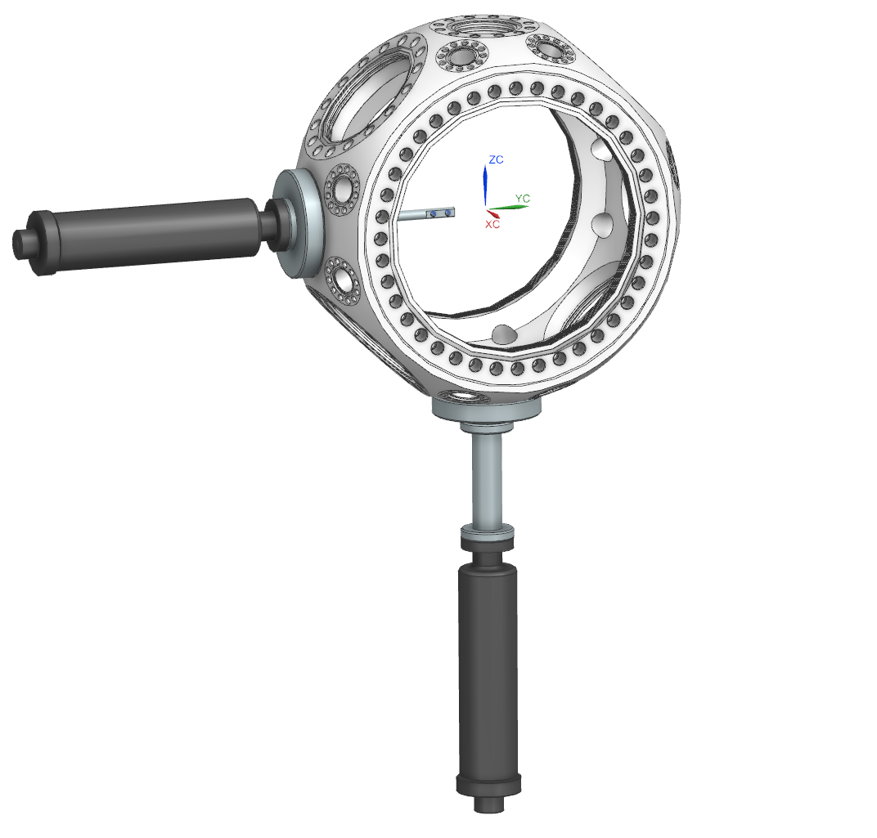
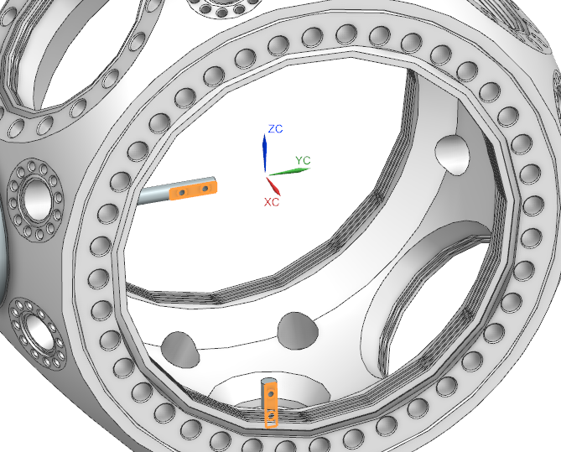
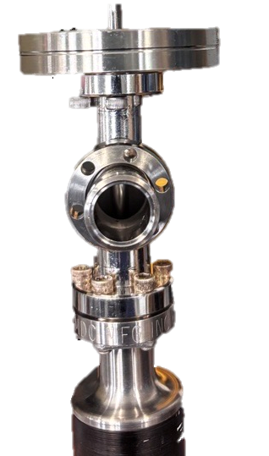
1. Install Linear Actuators
2.75” -> 1.33” Flange Adapter
“T” Extension
MDC Linear Passthrough
NOTE END EFFECTOR ORIENTATION

Slide 3
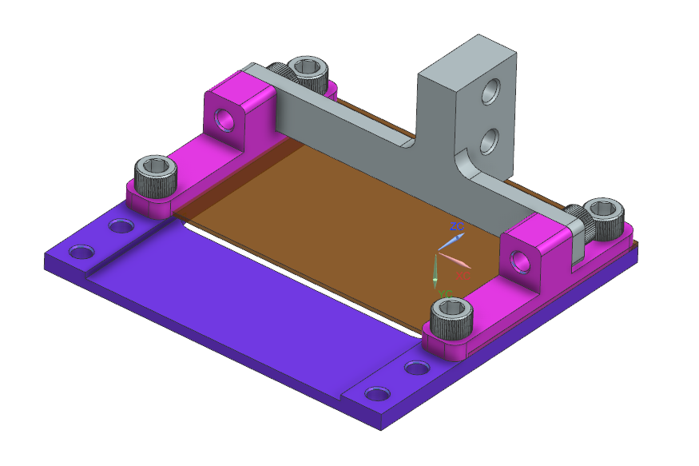
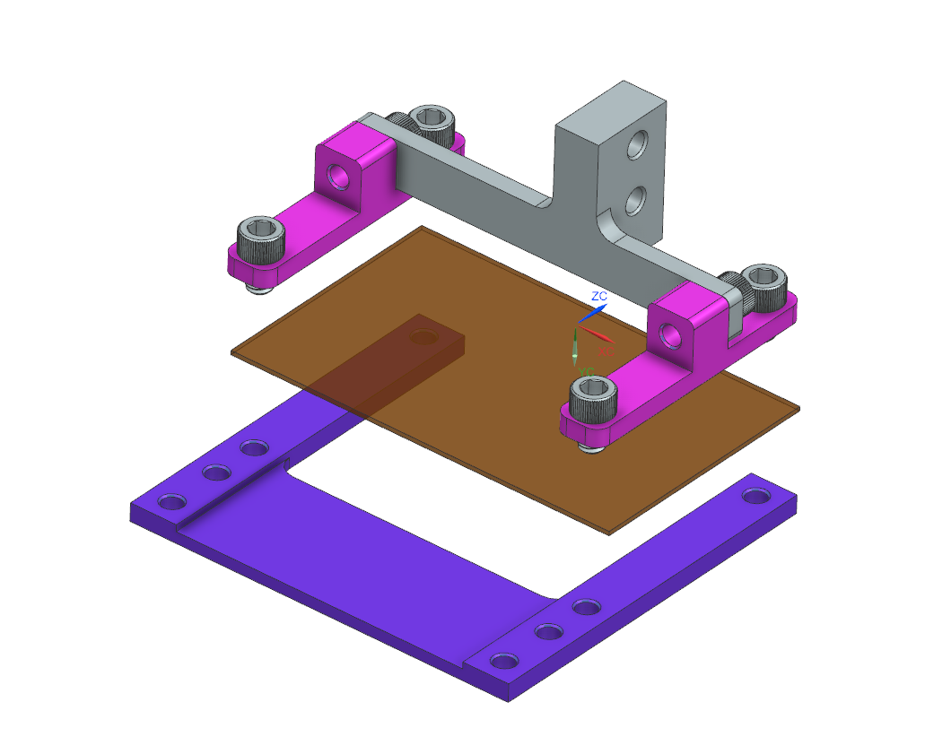
2. Assemble Horizontal Actuation
2x Mesh Clamp
Horizontal Mount
6x #8-32 ¼” bolts
Mesh
Film Plate

Slide 4
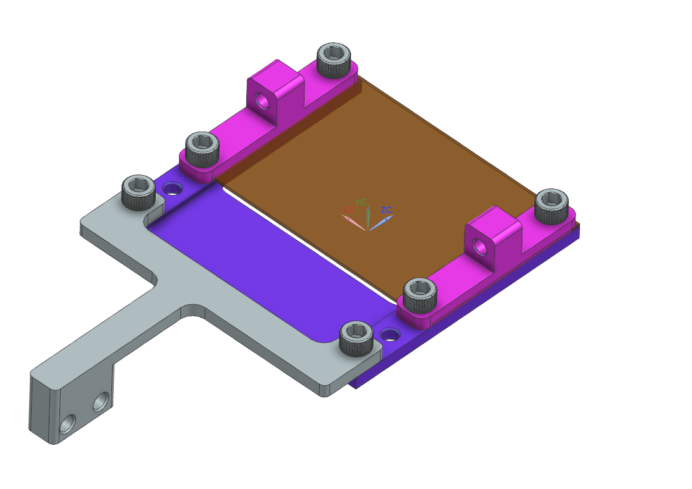
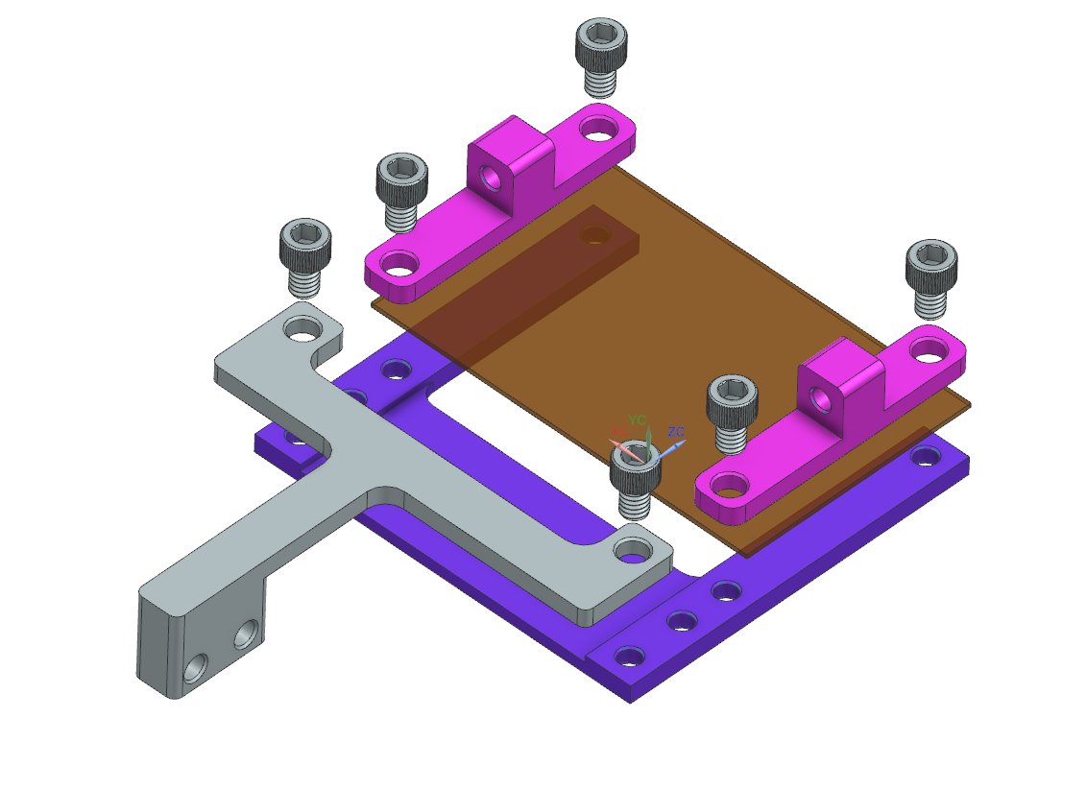
3. Assemble Vertical Actuation
2x Mesh Clamp
Mesh
6x #8-32 ¼” bolts
Film Plate
Vertical Mount

Slide 5
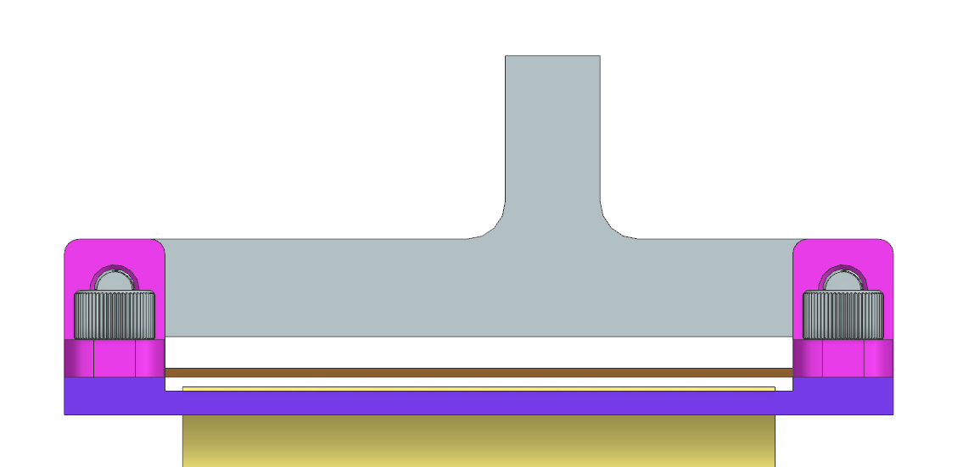

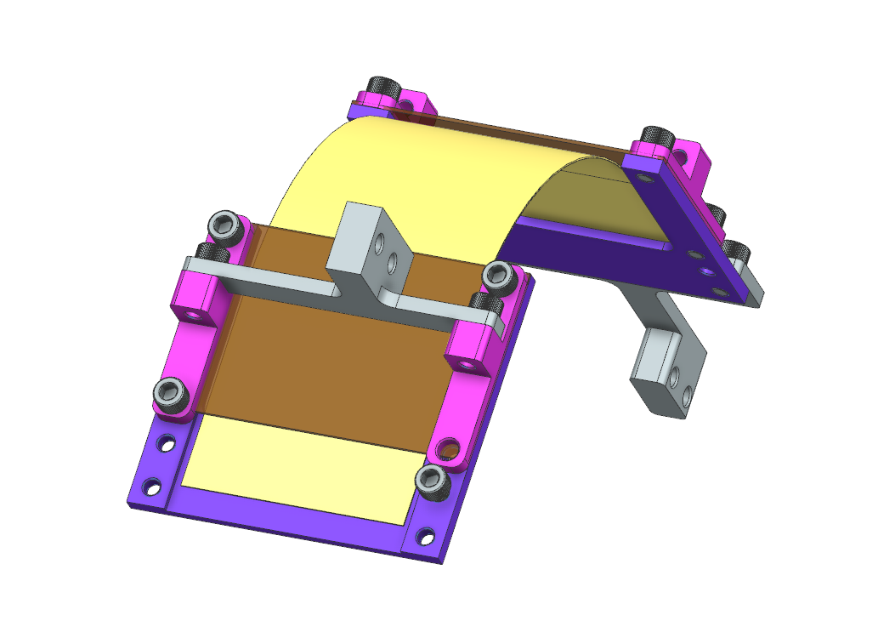
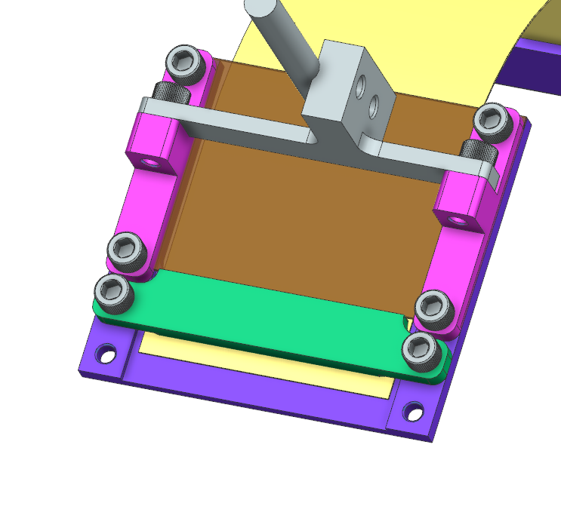
4. Install Film
Film
Mesh
Film Plate
Slide film underneath mesh
Film Clamp
2x #8-32 ¼” bolts

Slide 6
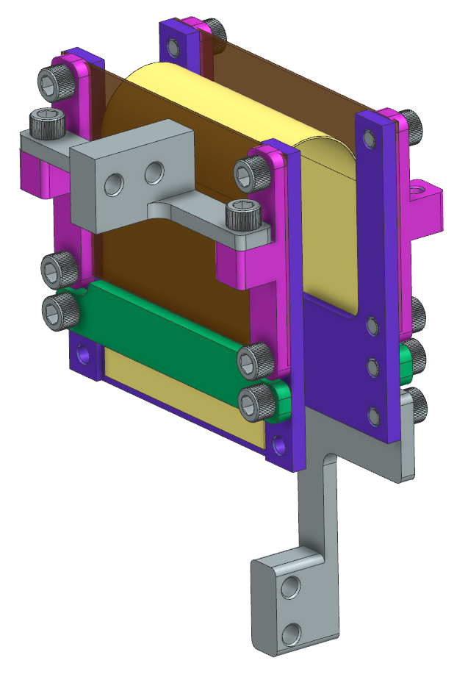
4. Install Film

Slide 7
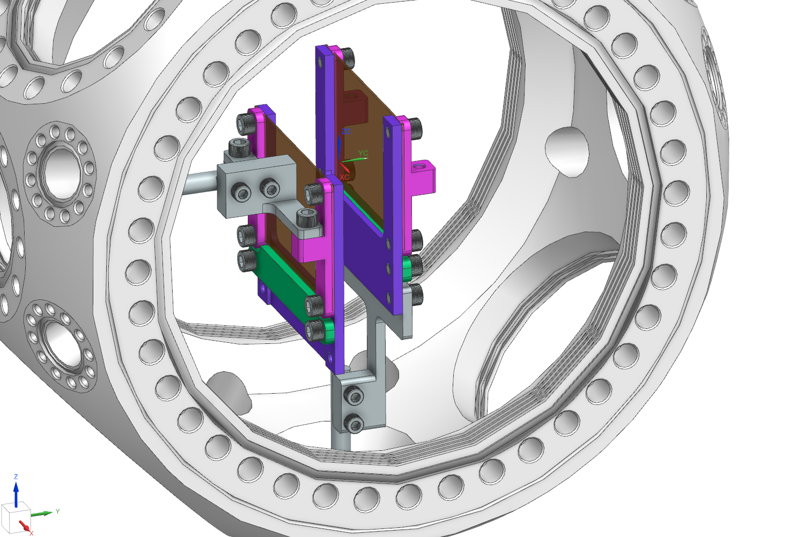
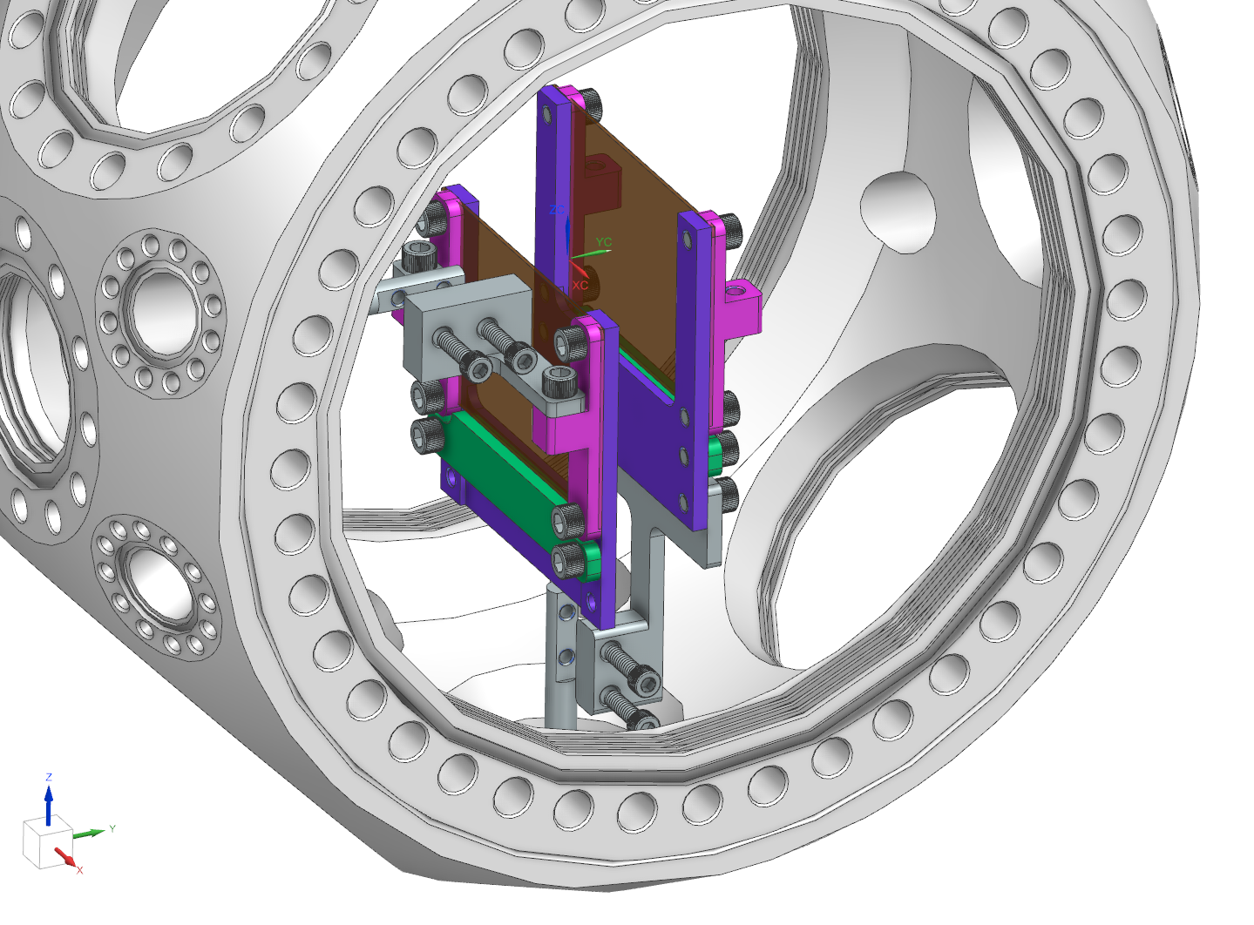
5. Install in Chamber
Vertical Actuation
4x #6-32 ½” bolts
Horizontal Actuation

